Slide 1
Computer Vision and Image Processing
Tirgul 8
Edge Detection
By Shai Aharon & Moriya Bitton

Slide 2
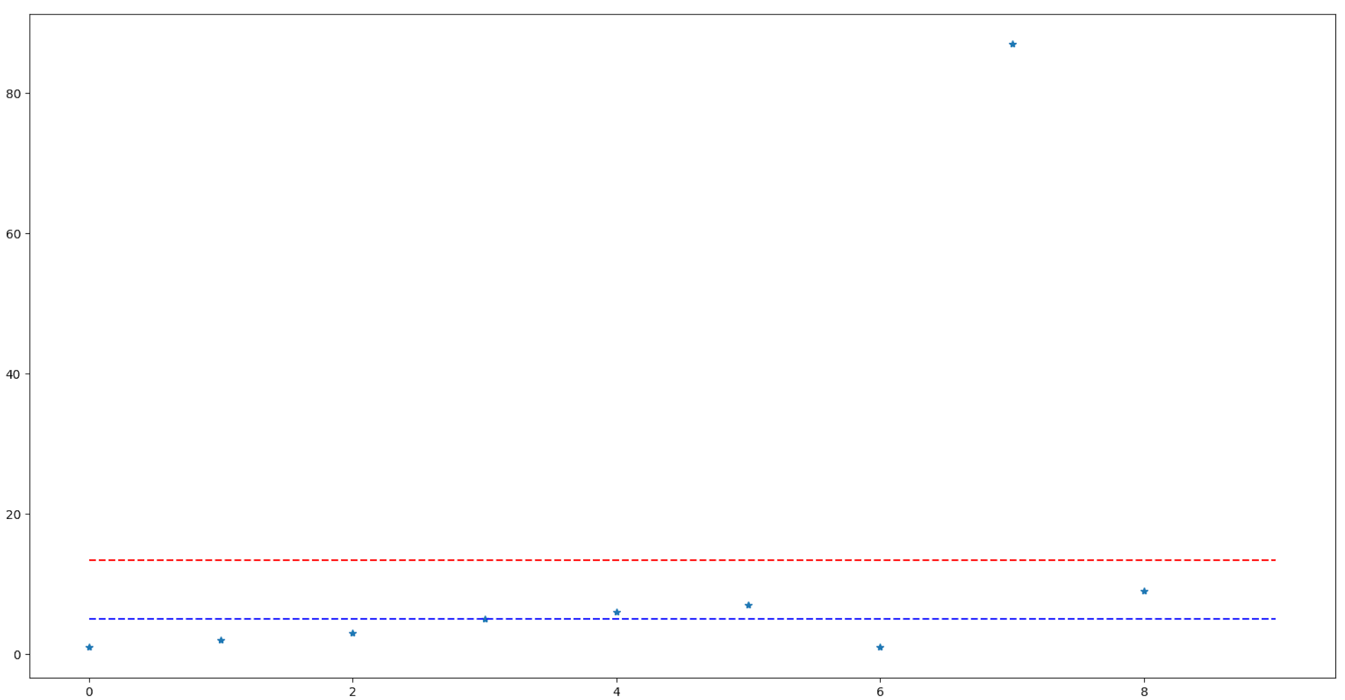
Median Vs Mean
Recap:
Median is the number in the array,
Mean is not necessarily a number in an array.
outlier
mean
median

Slide 3
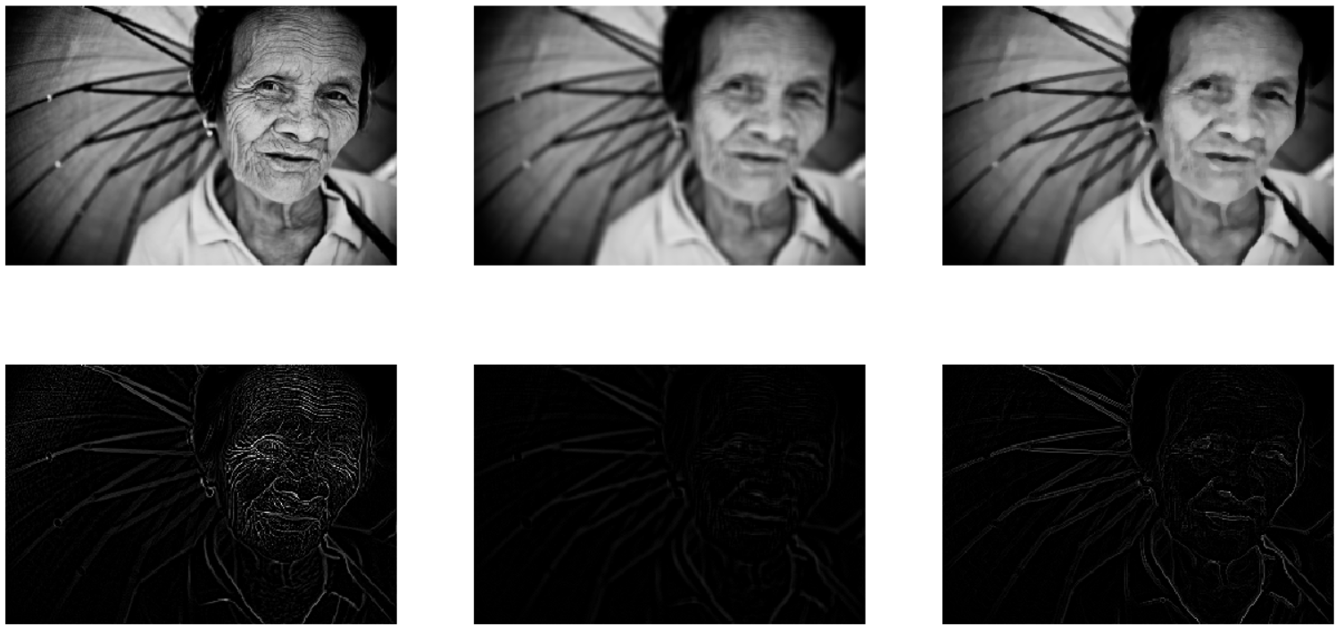
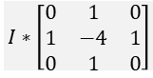
Median Vs Mean
Original
Mean
Median
$$I∗\left[\begin{matrix}0 & 1 & 0 \\ 1 & −4 & 1 \\ 0 & 1 & 0\end{matrix}\right]$$
Edges

Slide 4
Median Vs Mean
Edge preservant
Original
Mean
Median
Edges
Strong with noise
Weak
Strong with less noise

Slide 5
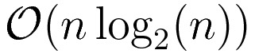
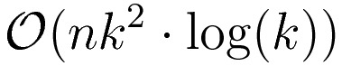
Median Vs Mean
 | Run time
Mean
Median | for naive implementation. You can use selection algorithms to shorten the time. There are some approximations that shorten the running time even more.

Slide 6
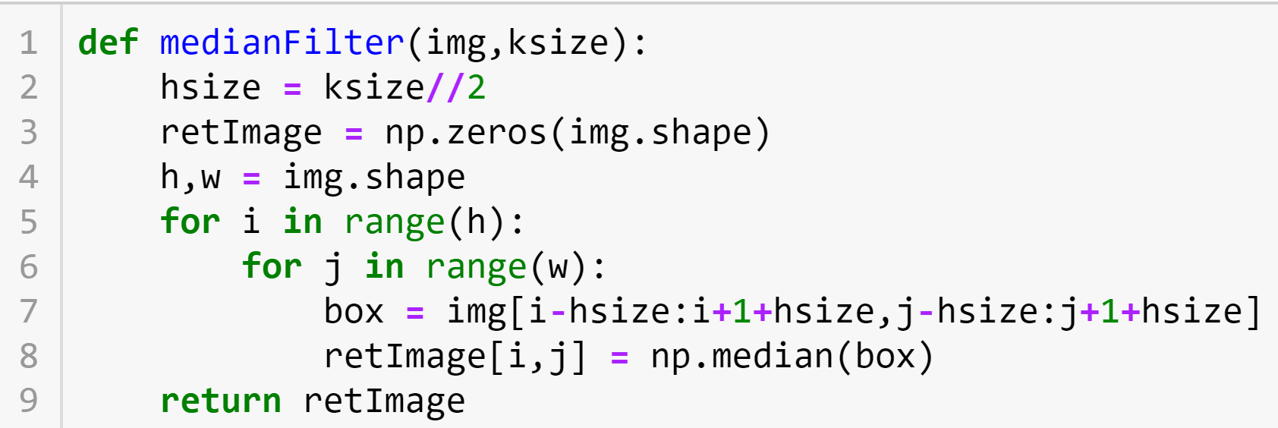
Median filter algo

Slide 7
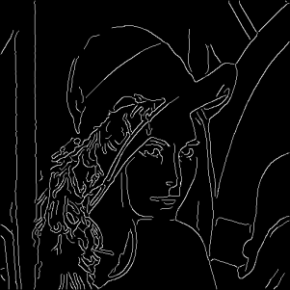
Edges

Slide 8
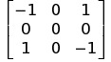
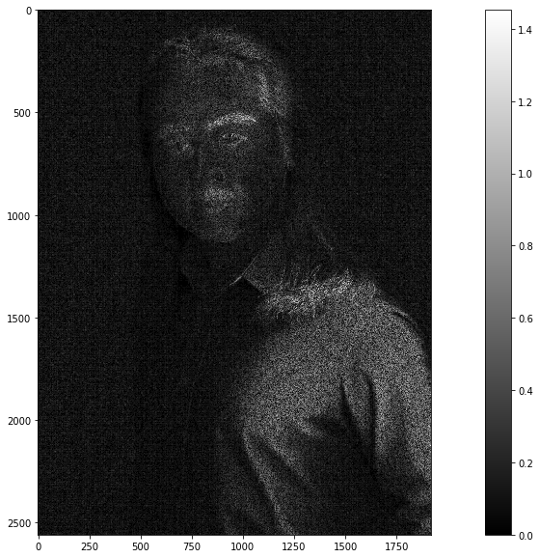
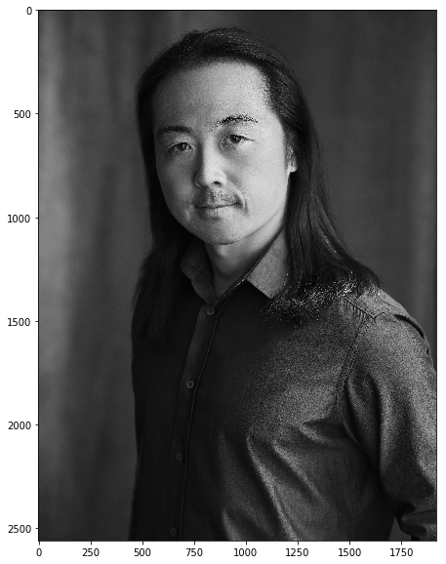
Recap

Slide 9
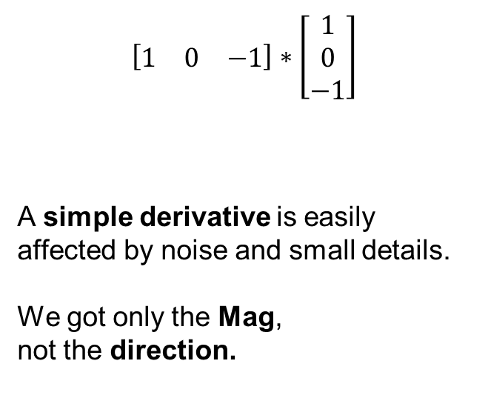
Conclusions
$$\left[\begin{matrix}1 & 0 & −1\end{matrix}\right]∗\left[\begin{matrix}1 \\ 0 \\ −1\end{matrix}\right]$$
A simple derivative is easily affected by noise and small details.
We got only the Mag, not the direction.
גזירה בכיוון Y
גזירה בכיוון X

Slide 10
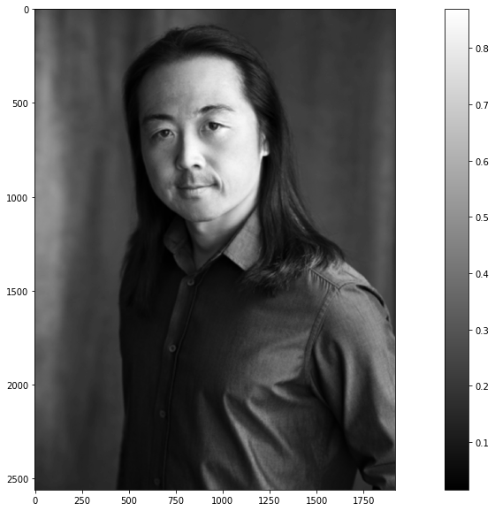
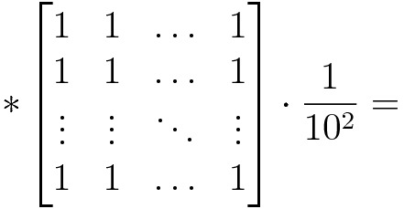
Solution I - Smooth before deriving

Slide 11
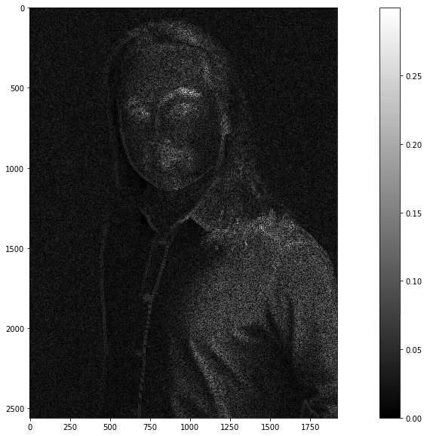
Solution I - Smooth before deriving
Better, but not perfect.
The ‘real’ edges have became weak.

Slide 12
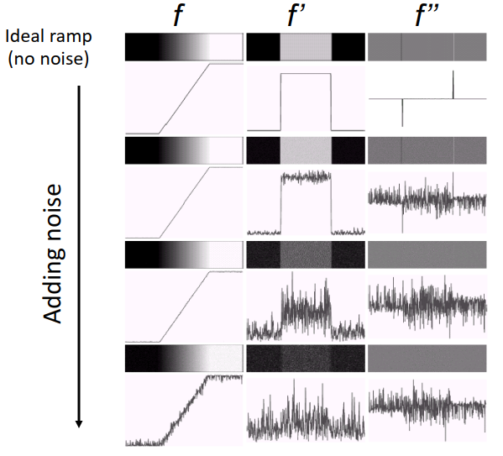
Solution I

Slide 13
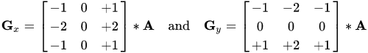
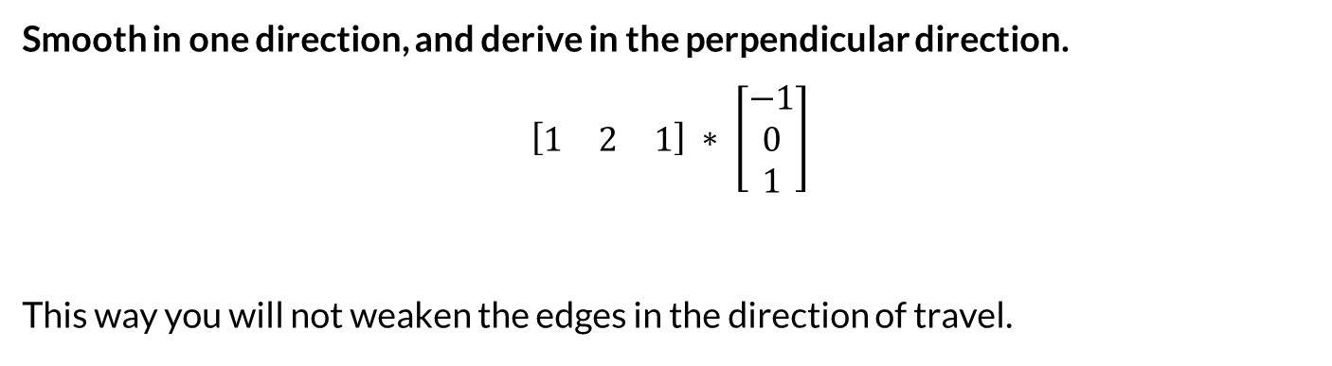
Solution II - Sobel
Smooth in one direction, and derive in the perpendicular direction.
$$\left[\begin{matrix}1 & 2 & 1\end{matrix}\right] ∗ \left[\begin{matrix}−1 \\ 0 \\ 1\end{matrix}\right]$$
This way you will not weaken the edges in the direction of travel.
גזירה בכיוון Y
"החלקה" בכיוון X

Slide 14
Solution II - Sobel
Smooth
Derive

Slide 15
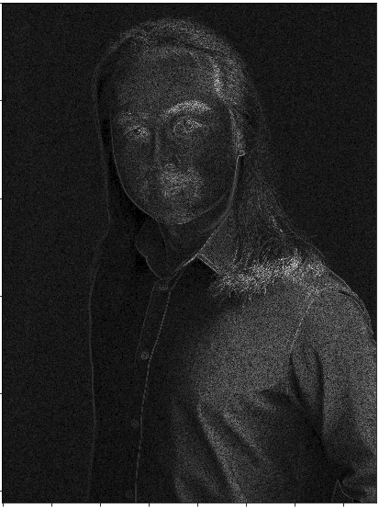
Solution II - Sobel
There are still noises but the Edges look better.

Slide 16
Laplacian Filter
Most edges are not ideal (not a step function)
Makes identifying the edges exact location difficult
If we use the Second derivative We can look for the "zero crossing" to pinpoint the edge location
Edge
Drived Edge
Sec Drived Edge

Slide 17
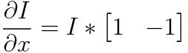
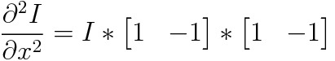
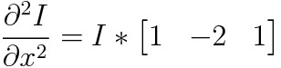
How to obtain the second derivative?

Slide 18
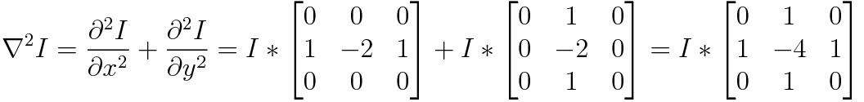
How to obtain the second derivative?

Slide 19
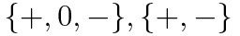
LoG: Laplacian of Gaussian
Smooth the image with a Gaussian filter
Convolve the smoothed image with the Laplacian filter
Find the following patterns:

Slide 20
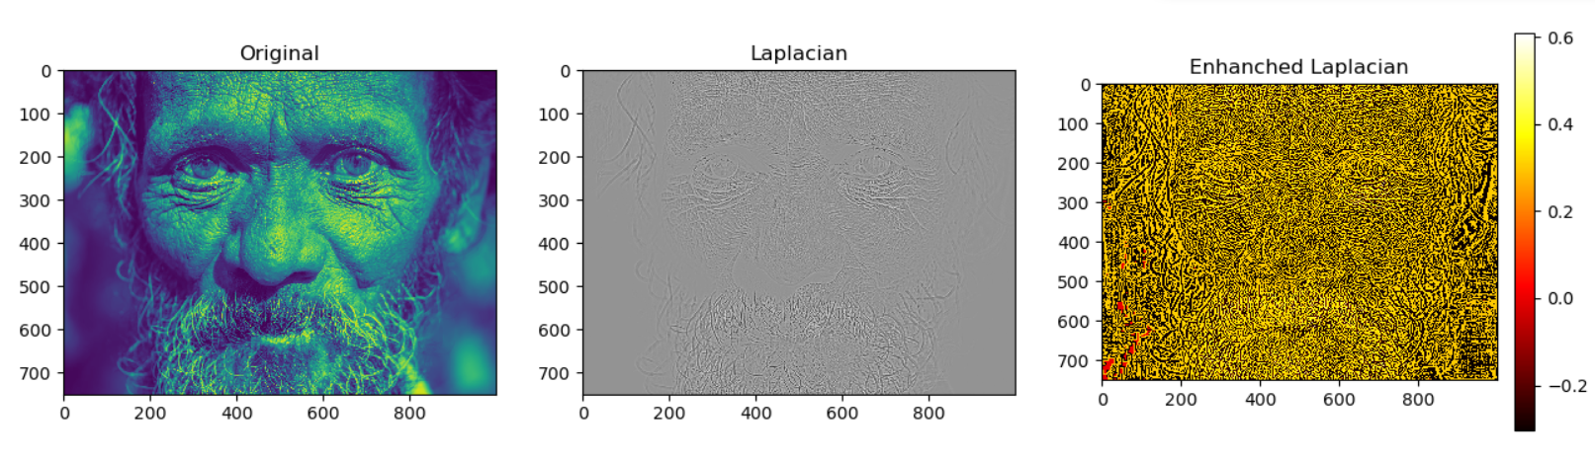
LoG

Slide 21
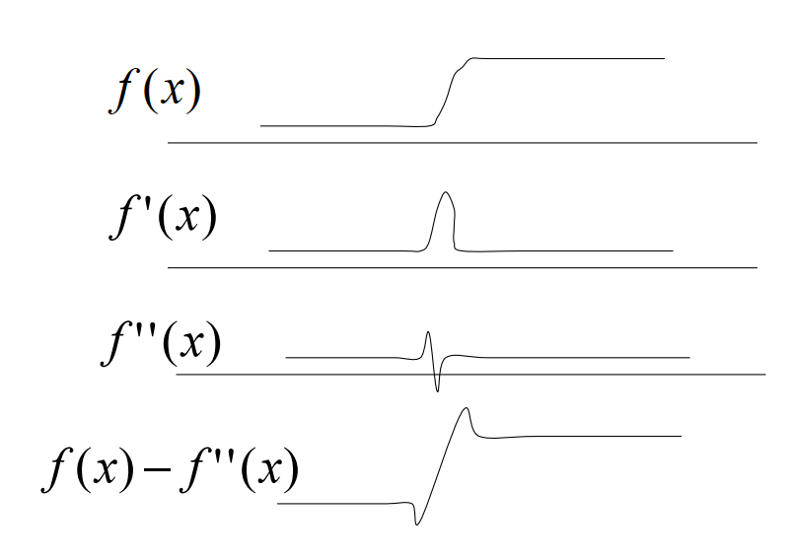
Image Sharpening via Laplacian
נדגיש מעבר בין הצבעים

Slide 22
Image Sharpening via Laplacian
org_I = np.array([
[0, 0, 0],
[0, 1, 0],
[0, 0, 0],
])
lap_ker = np.array([
[0, 1, 0],
[1, -4, 1],
[0, 1, 0],
])
img_sharp = cv2.filter2D(img, -1, org_I - lap_ker, cv2.BORDER_REFLECT)

Slide 23
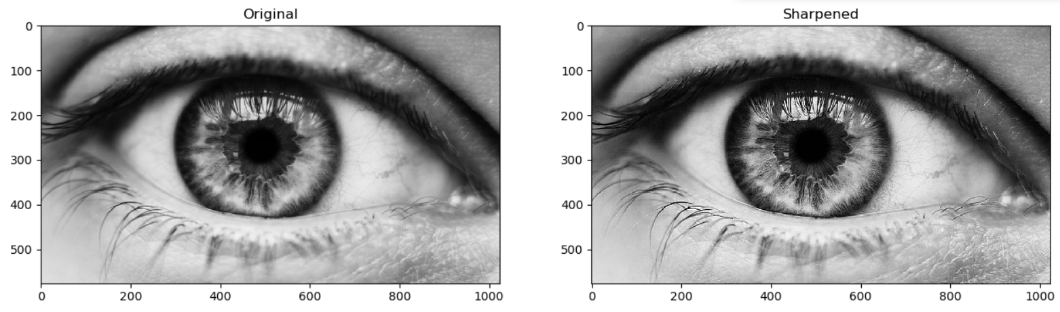
Image Sharpening

Slide 24
Bi-Lateral Filtering
Up until now, we looked at smoothing methods that take into account the neighbor’s colors based on distance only in a uniform (Box-Filter) or semi-uniform (Gaussian Filter) manner.
Fails around edges, where close pixels have very different values
Bi-Lateral Filter uses Gaussian filter, but “Gives” extra weight to pixels which are similar to the pivot (center) pixel.
How?

Slide 25
Bi-Lateral Filtering
$$I_{new}\left(x\right)=\frac{\sum_{p∈S_{x}}{e^{−\frac{\left|\left|x−p\right|\right|}{2σ_{r}}}}⋅e^{−\frac{\left|\left|I\left(x\right)−I\left(p\right)\right|\right|}{2σ_{c}}}⋅I\left(p\right)}{\sum_{p∈S_{x}}{e^{−\frac{\left|\left|x−p\right|\right|}{2σ_{r}}}}⋅e^{−\frac{\left|\left|I\left(x\right)−I\left(p\right)\right|\right|}{2σ_{c}}}}$$

Slide 26
Bi-Lateral Filtering
Gaussian smoothing
$$I_{new}\left(x\right)=\frac{\sum_{p∈S_{x}}{e^{−\frac{\left|\left|x−p\right|\right|}{2σ_{r}}}}⋅e^{−\frac{\left|\left|I\left(x\right)−I\left(p\right)\right|\right|}{2σ_{c}}}⋅I\left(p\right)}{\sum_{p∈S_{x}}{e^{−\frac{\left|\left|x−p\right|\right|}{2σ_{r}}}}⋅e^{−\frac{\left|\left|I\left(x\right)−I\left(p\right)\right|\right|}{2σ_{c}}}}$$

Slide 27
Bi-Lateral Filtering
Color similarity factor
Gaussian smoothing
$$I_{new}\left(x\right)=\frac{\sum_{p∈S_{x}}{e^{−\frac{\left|\left|x−p\right|\right|}{2σ_{r}}}}⋅e^{−\frac{\left|\left|I\left(x\right)−I\left(p\right)\right|\right|}{2σ_{c}}}⋅I\left(p\right)}{\sum_{p∈S_{x}}{e^{−\frac{\left|\left|x−p\right|\right|}{2σ_{r}}}}⋅e^{−\frac{\left|\left|I\left(x\right)−I\left(p\right)\right|\right|}{2σ_{c}}}}$$

Slide 28
Bi-Lateral Filtering
Color similarity factor
Gaussian smoothing
$$I_{new}\left(x\right)=\frac{\sum_{p∈S_{x}}{e^{−\frac{\left|\left|x−p\right|\right|}{2σ_{r}}}}⋅e^{−\frac{\left|\left|I\left(x\right)−I\left(p\right)\right|\right|}{2σ_{c}}}⋅I\left(p\right)}{\sum_{p∈S_{x}}{e^{−\frac{\left|\left|x−p\right|\right|}{2σ_{r}}}}⋅e^{−\frac{\left|\left|I\left(x\right)−I\left(p\right)\right|\right|}{2σ_{c}}}}$$
Normalization

Slide 29
Bi-Lateral Filtering- Demo
def bilateral():
img = cv2.imread('eye.jpg', cv2.IMREAD_GRAYSCALE) / 255.0
k2_size = 10
y, x = 300, 667
pivot_v = img[y, x]
neighbor_hood = img[
y - k2_size:y + k2_size + 1,
x - k2_size:x + k2_size + 1
]
sigma = .01
diff = pivot_v - neighbor_hood
diff_gau = np.exp(-np.power(diff, 2) / (2 * sigma))
gaus = cv2.getGaussianKernel(2*k2_size+1, k2_size)
gaus = gaus.dot(gaus.T)
combo = gaus * diff_gau
result = combo*neighbor_hood /combo.sum()

Slide 30
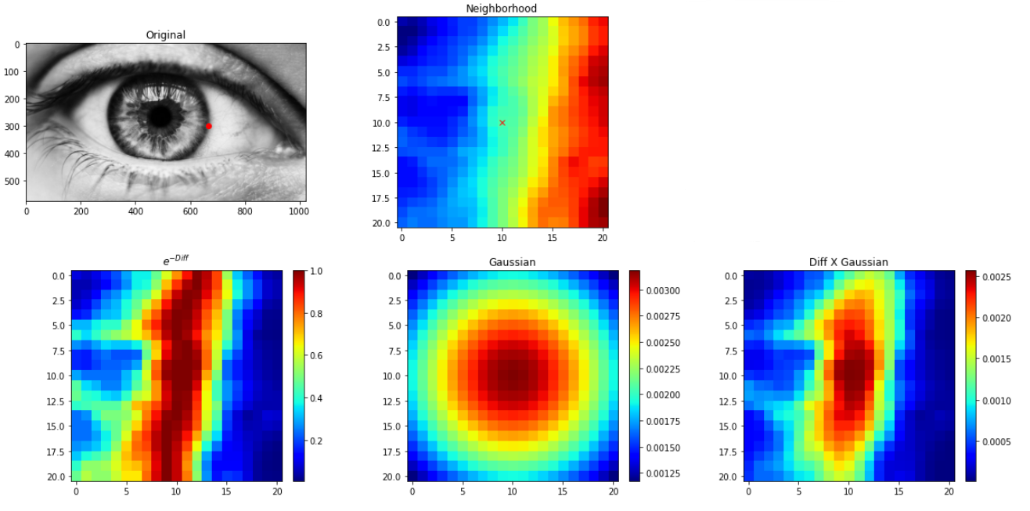

Slide 31
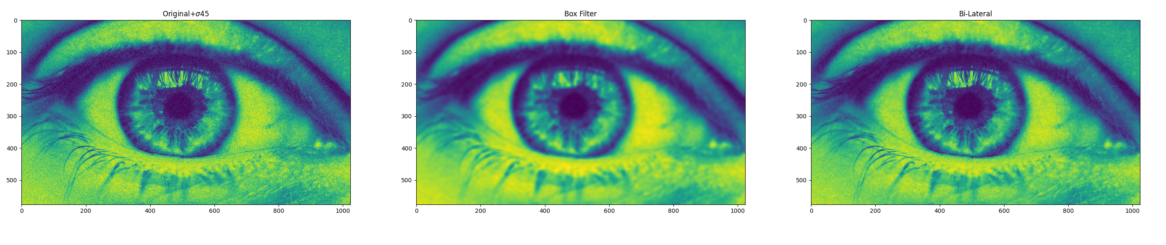
Bi-Lateral Filtering

Slide 32
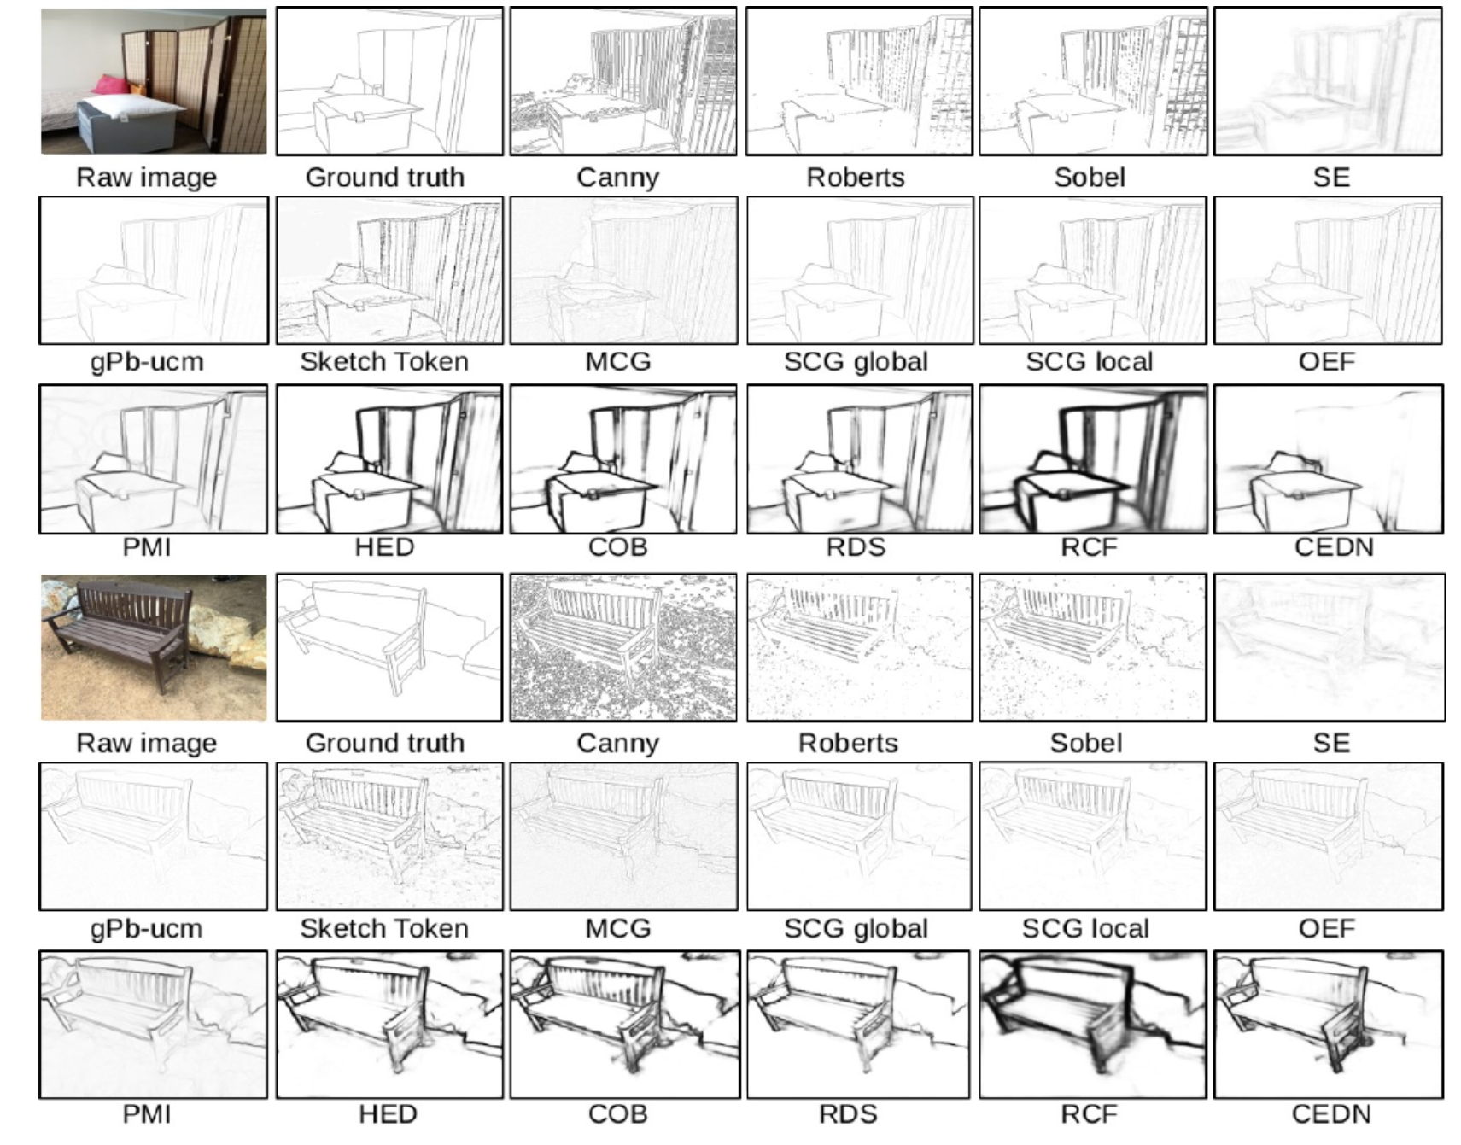
What’s next?
There is a lot of work done, trying to detect ‘real’ edges and not just texture.
For those who are interested, I recommend reading ‘Structured Forest for Edge detection’

